Slide 1
THE SHRIVER CENTER BUSINESS SERVICES UNIT NEW EMPLOYEE ORIENTATION

Slide 2
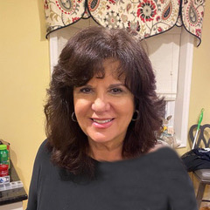
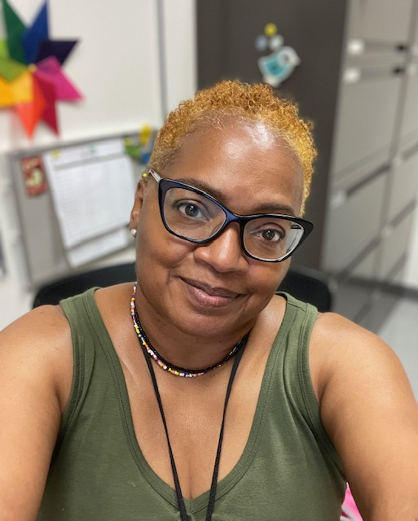
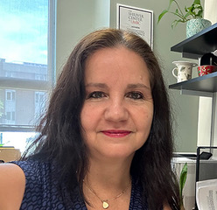
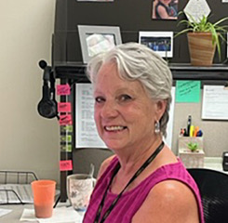
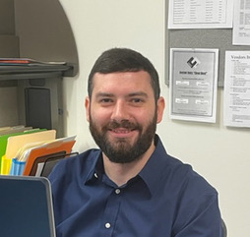
Meet The Staff
Stephanie Farina
Business Manager
Shirley Carrington
Office Manager
Susy Pincheira
Supervisor Accounts Payable/Accounts Receivable
Shelly Johnson
Supervisor Payroll/HR
Cathy Bowen
Accounts Payable/Accounts Receivable
Robert Melchor
Accounts Payable/Accounts Receivable /Payroll
Shahid Mokal
IT/Technology

Slide 3
Stephanie Farina sfarina@umbc.edu 410-455-2392
How to get things done
You are a government employee
Check email often
If you are not sure – please ask

Slide 4
Shirley Carrington shirleyc@umbc.edu 410-455-2494
Campus ID
Parking
Building and office access
Scheduling meetings and events
Office facilities/equipment

Slide 5
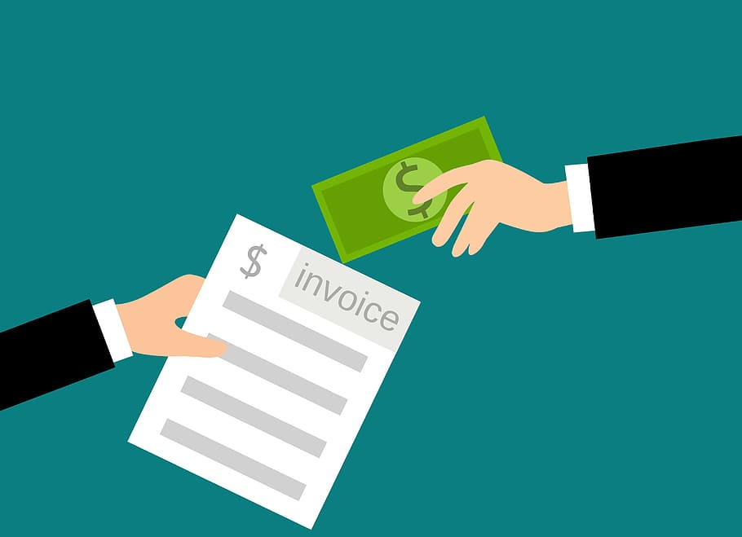
Susy Pincheira pincheir@umbc.edu 410-455-1802
Robert Melchor melc1@umbc.edu 410-455-2866
Cathy Bowen bma@umbc.edu 410-455-2635
Purchasing
Reimbursements
Travel

Slide 6
HOW TO BUY/PAY/GET REIMBURSED
Purchasing Card (Pcard/UMBC Visa)
To pay for all transactions allowable by UMBC that are less than $5000.
Payment Request
To pay vendors that cannot be paid via Pcard/reimbursements for staff.
Payments can take up to 30 days.
Petty Cash
To reimburse staff for out-of-pocket supply purchases (last minute purchases done with cash or debit card). Credit card payments must be processed via the PAW system by Payment Request.
Working Fund
To pay vendors when specific circumstances exist. The payment will not be approved if it can be handled by any other method – Pcard, Procurement, Accounts Payable, etc..
Checks are only cut once a week (Thursdays) so it is imperative that payment requests are submitted as early as possible - at least 7 days in advance.

Slide 7
WHAT WE NEED FROM YOU
Detailed receipts in pdf format
Invoice made out to UMBC
W9
Agenda, invitation, list of attendees, flyer (pdf format)
Project number to be charged
Approval from supervisor
Please submit your requests for payments via email to: Robert Melchor or Cathy Bowen

Slide 8
TRAVEL
In-State Travel
Necessary Items (Must be in PDF format):
Mileage Log (Choice Staff)
Itemized Receipts (Must show date and proof of purchase)
Choice Statement for Travel Expenses (Choice Staff)
If applicable – Late memo or overage memo signed by your Supervisor
Reimbursements should be submitted bi-weekly. Please review travel calendar provided
Please be on the lookout for the DocuSign version of your travel expense after submission. You will need to sign it so it is released for processing
Reimbursements can take up to 30 days to be received
Out-of-State Travel
Pre-approval is required for any out of state travel, if Washington DC, only if staying overnight.
Plan Ahead
Allow as much time as you can to get early bird rates on registration, flights, etc.
Hotels and registrations will be paid for with a P-Card
Travel arrangements will be reserved with a Travel Agent through the Pre-Approval
Your reimbursement for any out of pocket expenses must be completed within 10 days of returning from your trip

Slide 9
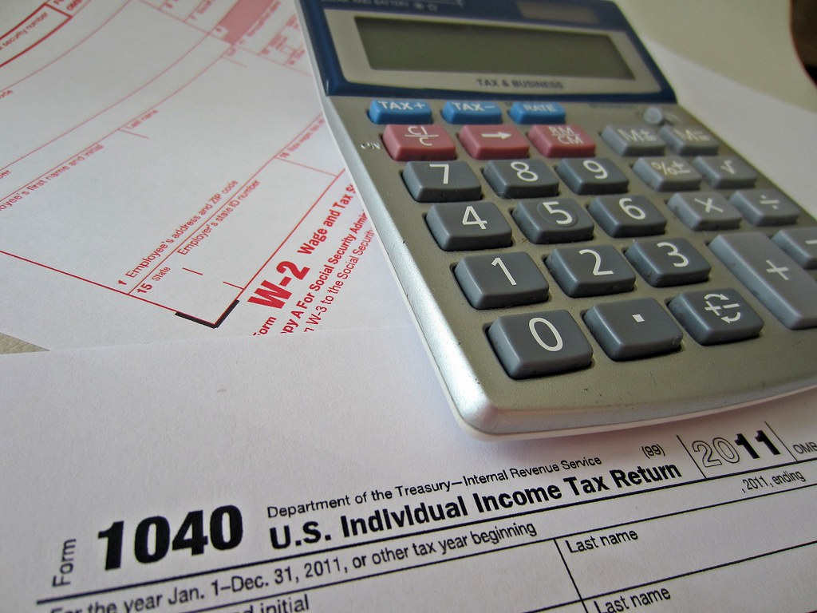
Shelly Johnson shellyj@umbc.edu 410-455-1343
Tax and Direct Deposit Forms
Timesheets (see screenshots)
Payroll On-Line Service Center (POSC)
Holiday Leave Schedule

Slide 10
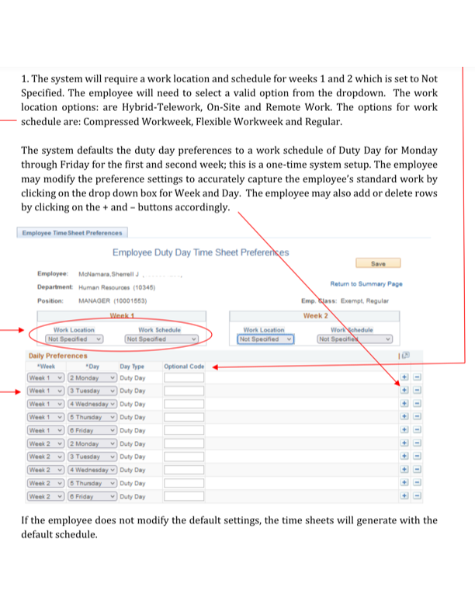

Slide 11
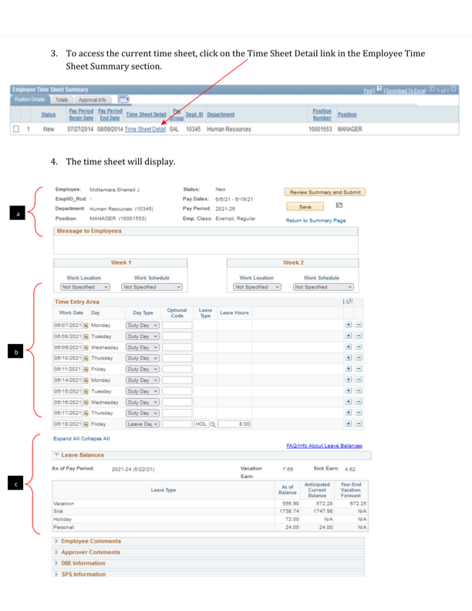

Slide 12
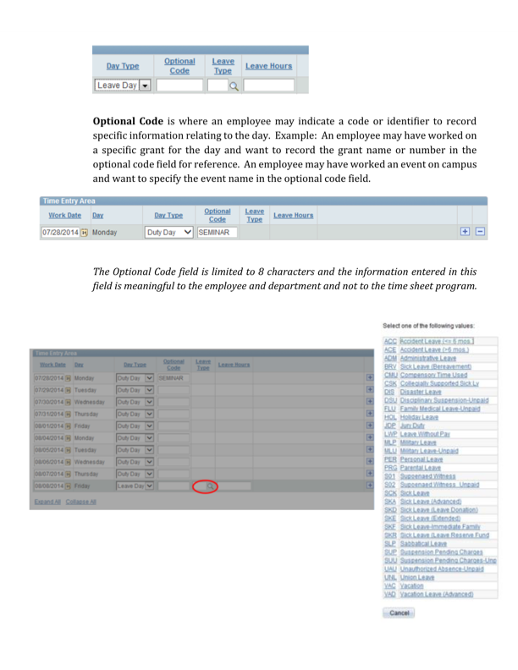

Slide 13
Shahid Mokal shahid@umbc.edu
Computer Set-Up
Webex
RT ticket
IT video message

Slide 14
Questions
Questions

Slide 15
Questions
WHAT DID YOU LEARN?

Slide 16
Questions
FEEDBACK

Slide 17
HELPFUL LINKS
CAMPUS ID
PARKING
SHRIVER SWIPE CARD ACCESS
GOOGLE CALENDAR
SHRIVER IT RT TICKET
PAW (ASSIGN CARTS – example: amazon purchases)
SHRIVER FORMS (MILEAG LOG, INSTRUCTIONS “HOW TO”, ETC.)
UMBC TRAVEL DASHBOARD
HUMAN RESOURCES
ELECTRONIC TIME SHEETS REFERENCE

